Slide 1
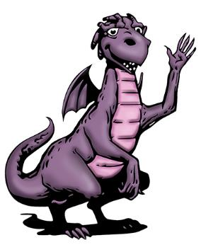
Module 1, Session 1
Strange Creatures

Slide 2
Story characters

Slide 3
Strange Creatures

Slide 4
Strange Creatures

Slide 5
Strange Creatures

Slide 6
Strange Creatures

Slide 7
Strange Creatures

Slide 8
Strange Creatures

Slide 9
Strange Creatures

Slide 10
Strange Creatures

Slide 11
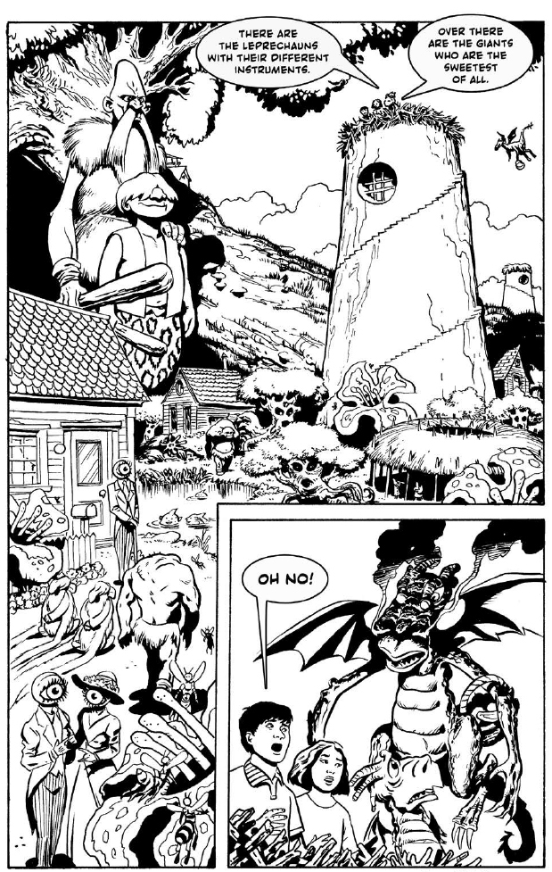
Strange Creatures

Slide 12
What makes us unique?

Slide 13
Liked
Learned

Slide 14
Key message
Each of us has many characteristics which make us who we are and make us different and special. In our class, the differences between us are a source of strength and we can bring all our talents together.

